Slide 1
Mini sari-sari store management system
Created by:
COC-FAB-BSIT2-08

Slide 2
WHAT IS OUR SYSTEM?
Our project is a simple Mini Sari-sari store management system that helps our client manage and monitor his products, sales, and his customer’s utangs.

Slide 3
System’s Design
Our system’s design is made to be simple, interactive, and easy to use. Aside from that, it is more organized and had a clear layout so that our client can use it easily and can organize his products efficiently.

Slide 4
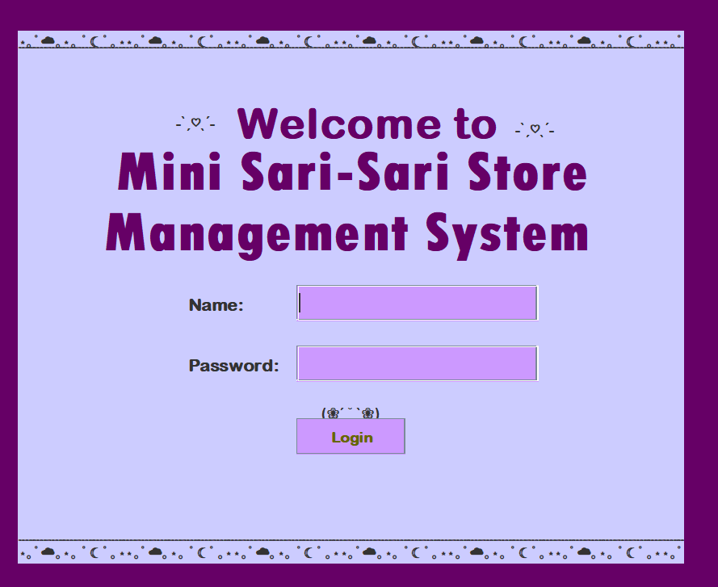
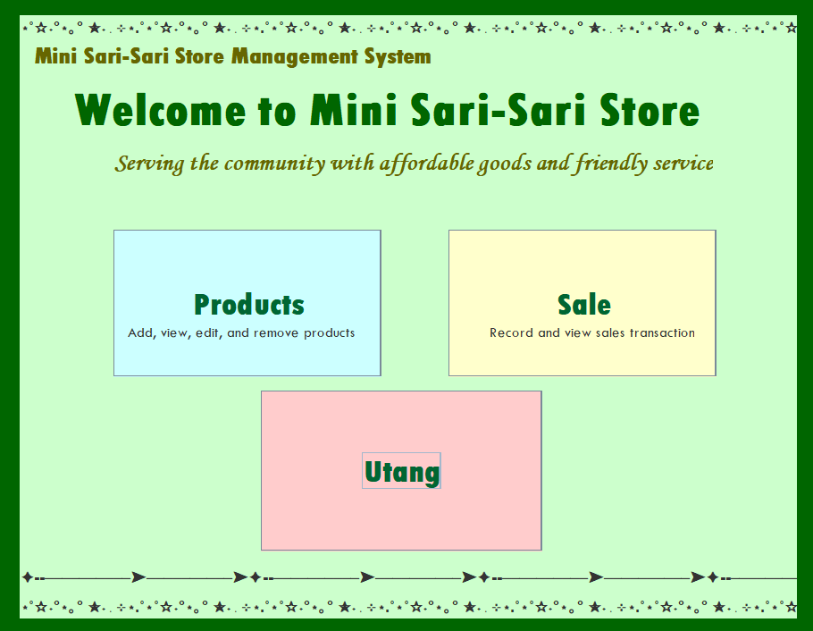
System’s INTERFACE

Slide 5
CODE source
We’ve used simple buttons, textfields, and other parts of the GUI functions. We made sure to put our existing knowledge that we’ve learned from the OOP. We also added the CRUD method that handles adding, viewing, updating, and deleting.

Slide 6
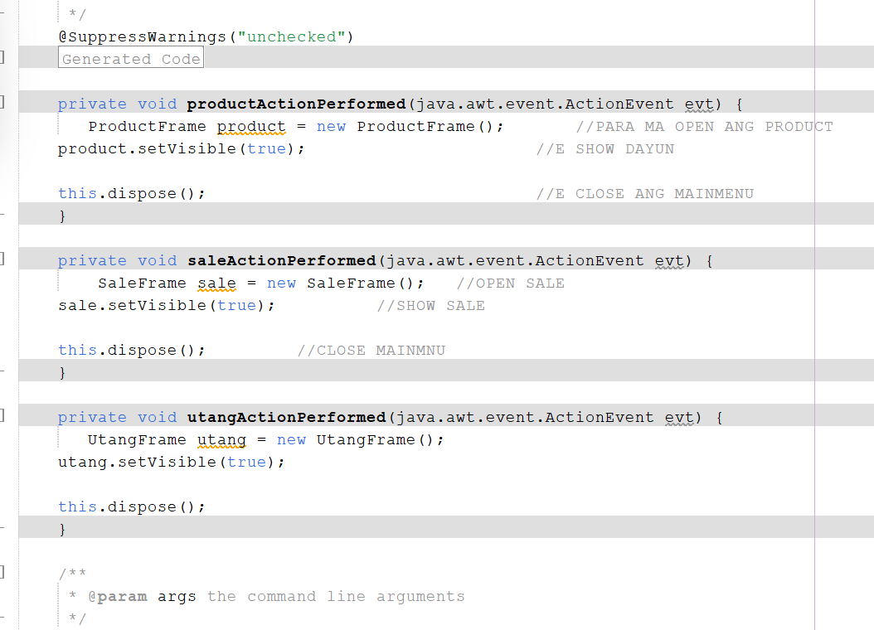
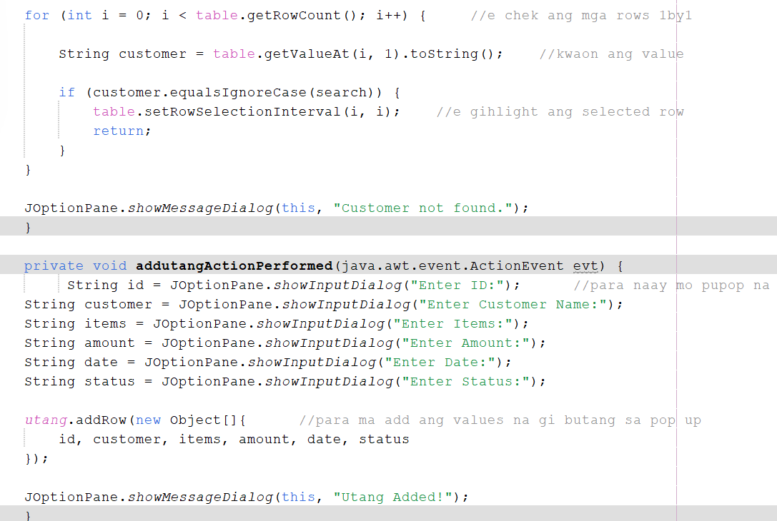
System’s SNIPPETS

Slide 7
Conclusion
Overall, our system is made to be clean, organized, and user friendly. It allows the client to record and manage his/her products, sales/customers transaction, and customers utangs.

Slide 8
THANK YOU ^O^

